Slide 1
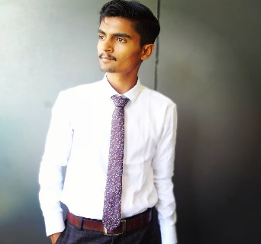


Daksh Prajapati
Web Developer
Contacts
Profile
  TO seek a position in an organization where I can grow my Technical Abilities & knowledge to contribute to the grow of the organization simultaneously will help me to fulfill my career objectives in this rapidly changing filed
+91 9724884061
daksh3211@gmail.com
https://www.linkedin.com/in/daksh-prajapati-9652a3240
https://github.com/DAKSHBP3211
Education
ITI - ICTSM
Technical Skills
Industrial Training Institute
  HTML ( HTML5 )
  CSS
  ADVANCE CSS
  JAVASCRIPT
  BOOTSTRAP
  TAILWIND
  WORDPRESS
2022 - 2024
HSC – D.D. Choksi Vidyalaya
2024
SSC - GSEB
2017
Skills
  Time Management
  Creativity
  Problem Solving
  Adoptable
  Team-Work
Certification
Diploma in Website Designing And Development – Tops Technologies 2025
Projects
Experience
Dream Pulse Business
    Telecaller – Northstar Diagnostics Pvt. Ltd.
    Aug-2024 – Nov. - 2024
    Computer Operator – Vardhman Health
    Specialities Pvt. Ltd. – Nov.-2024 – Mar. - 2025
    Telecaller - Ascendum KPS Pvt. Ltd.
    Mar.-2025 - jun. – 2025
Dream Pulse Business is a business profile website . This is the web designing
Project Using a Markup Languages like HTML & CSS . There is many sides in this website page like Introduction , About Us , Our Work , Our Clients and Registration form for visit the site .
https://github.com/DAKSHBP3211/WD_10-ASSESSMENT.HTML5

